Slide 1
Natural Language Processing
Arif Istiake Sunny
sunny1509006@gmail.com

Slide 4
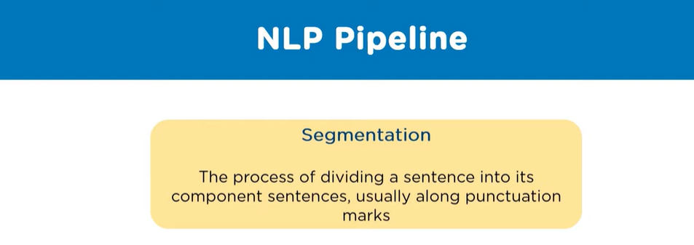

Slide 5
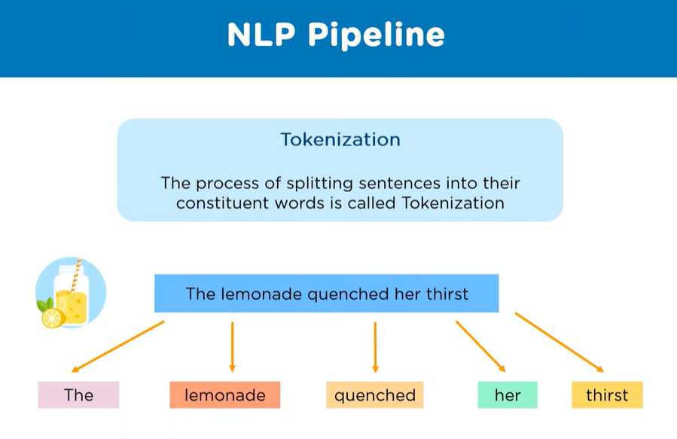

Slide 8
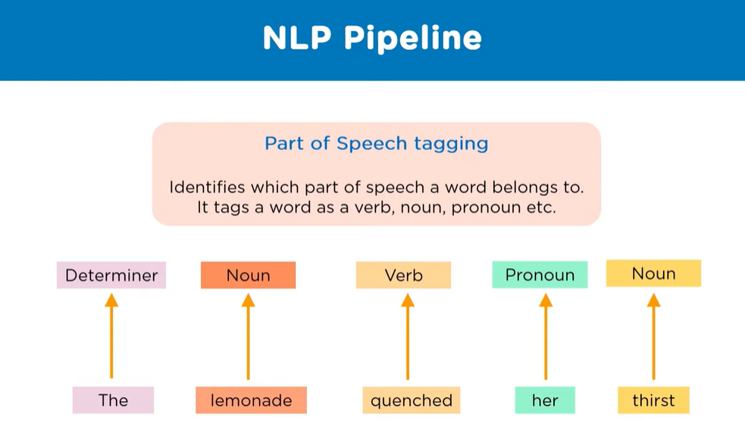

Slide 9
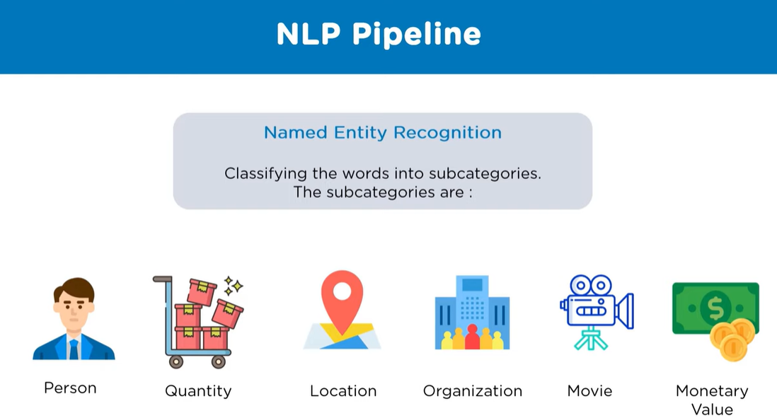

Slide 10
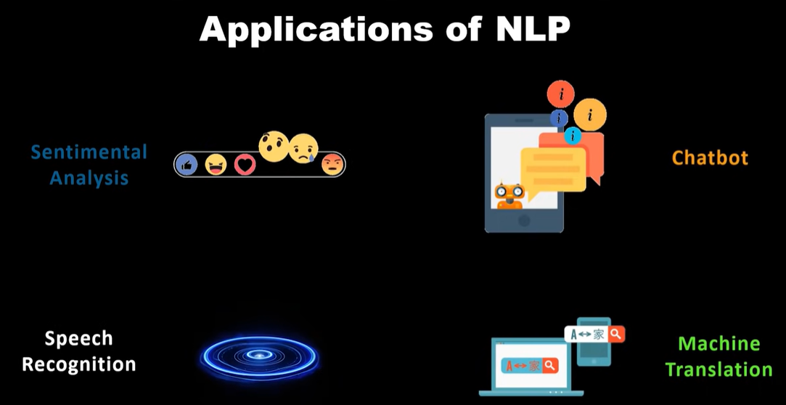

Slide 11
